Slide 1
Introduction to RDD

Slide 2
What is RDD?
RDD Characteristics
Partitions
Read - Only
RDD operations
Creating an RDD

Slide 3
What is RDD?
RDD (Resilient distributed dataset)
Fundamental data structure of Apache Spark.
Resilient - In built fault tolerance. If something goes wrong reconstruct from source (Lineage).
Distributed - data is distributed in memory across the worker nodes.
Dataset - represents records of the data.
RDD
Executor
rdd_0
Executor
rdd_1
Executor
rdd_2

Slide 4
What is RDD?
RDD is an immutable collection of objects which computes on the different node of the cluster.
Dataset in RDDs are logically partitioned across many nodes for parallel computation.
Spark Worker 1
Spark Worker 2
Spark Worker 3
Resilient Distributed Dataset

Slide 5
RDD Characteristics
Partitions:
RDD represent data in memory.
To handle huge volume of data
data is divided in to partitions that are distributed to multiple machines called nodes.
process data in parallel.

Slide 6
RDD Characteristics
Ready - Only:
RDDs are immutable.
can not be modified in place.
to modify, there are only two types of operations.
Transformations
Actions

Slide 7
RDD Operations
Transformation:
Converts an RDD into another RDD.
Transform records in dataset.
Once a dataset is loaded into memory, you can perform chain of transformation before you see some results.
Example:
Filtering out only certain records.
Extracting specific field.
Transformation
Base RDD
New RDD

Slide 8
RDD Operations
Actions:
The actual data processing doesn’t happen immediately.
It happens only user requests a result.
Example:
First 10 rows
A Sum
A Count
Action
RDD
Value

Slide 9
Creating an RDD
Two ways to create an RDD.
by loading an external dataset, or
by distributing a collection of objects (e.g., a list or set).

Slide 10
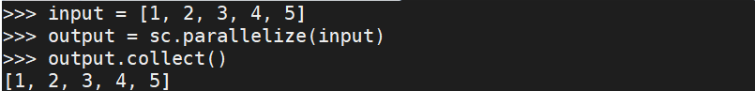
Creating an RDD - Using Parallelized Collections
Parallelized Collections:
Objective: Creating an RDD using parallelized collection method of Spark Context.
Action:
Output:
input = [1, 2, 3, 4, 5]
output = sc.parallelize(input)
output.collect() # To display output on the console
Note: collect() is an Action

Slide 11
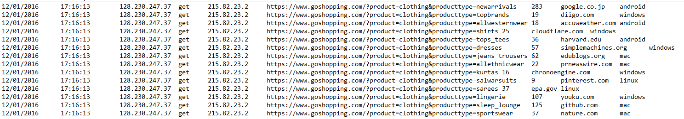
Creating an RDD – Using Text File
File based RDD:
TextFile RDD can be created using textFile method of Spark Context.
Input Data:
File Name: "goShopping_WebClicks.dat " (contains user activity)
Notes:
File : goShopping_WebClicks.dat
* Contains the activities of all users for the duration Dec 2016 (12/01/2016 to 12/29/2016).
Meta Data Description: 9 fields
note: The fields are seperated by tab (\t) delimiter.
date:
* Data type to be considered - String
* The date when the user (IP) accessed the website
time:
* Data type to be considered - String
* The time when the user (IP) accessed the website
hostIp:
* Data type to be considered - String
* The IP address of the machine where the website is hosted when the user accessed the website
cs-method:
* Data type to be considered - String
* The request method used for accessing the content in the website
customer-ip:
* Data type to be considered - String
* The IP address of the the user who accessed the website
url:
* Data type to be considered - String
* The URL which was accessed by the User
time-spent:
* Data type to be considered - Int
* The total time spent in seconds by the user on the particular URl
redirectedFrom:
* Data type to be considered - String
* The source url where the request was redirected to the website
deviceType:
* Data type to be considered - String
* The type of device in which the user accessed the website

Slide 12
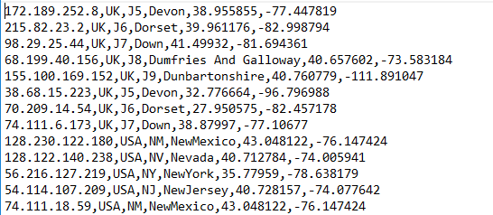
Creating an RDD – Using Text File
Input Data:
File Name: "goShopping_IpLookup.txt" (contains user IP details)
Notes:
File : goShopping_IpLookup.txt
* Contains the details of all users who accessed the website.
Meta Data Description: 6 fields
note: The fields are seperated by comma (,) delimiter.
IP:
* Data type to be considered - String
* The IP address of the user
Country:
* Data type to be considered - String
* The country where the IP address accessed the website.
State:
* Data type to be considered - String
* The state of the country where the IP address accessed the website.
City:
* Data type to be considered - String
* The city of the country where the IP address accessed the website.
ApproxLat:
* Data type to be considered - String
* The Approximate latitude where the IP address accessed the website.
ApproxLng:
* Data type to be considered - String
* The Approximate longitude where the IP address accessed the website.

Slide 13
Creating an RDD – File Partitioning
Partitions - single file
Partitions is done based on size.
You can specify the number of partitions as shown below.
textFile(filename, minPartitions)
The default number of partitions: 2
more number of partitions = more parallelization
RDD
Executor
rdd_0
goShopping_WebClicks.txt
Executor
Executor
sc.textFile("goShopping_WebClicks.txt",1)

Slide 14
Creating an RDD – Using Text File
Objective: Create an RDD for user activity (Use Local File System).
Action:
Output:
LocalFSRdd = sc.textFile("file:///home/vagrant/dataset/goShopping_WebClicks.dat") # URL of the local FS
LocalFSRdd.count() # count() is an action, counts the number of records.

Slide 15
Creating an RDD – Using Text File
Objective: Create an RDD for user activity (Use HDFS File System).
Action:
Output:
HDFSRdd = sc.textFile("hdfs://192.168.56.70:9000/data/goShopping_WebClicks.dat") # URL of the HDFS path.
HDFSRdd.count()

Slide 16
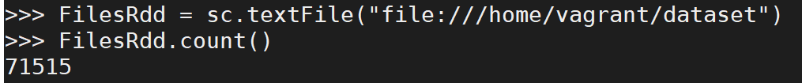
Creating an RDD – Using Text File
Objective: Create an RDD for user details and activity.
Action:
Note: Directory dataset contains user activity and user details.
Output:
FilesRdd = sc.textFile(“file:///home/vagrant/dataset")
FilesRdd.count() # count () is an action

Slide 17
Questions
Notes:
Application Delivery Fundamentals (ADF) 2.0: Testing
Module 02: Introduction to Software Development Life Cycle (SDLC)

Slide 18
Thank You

